Slide 1
Router Hardware
Welcome, students!

Slide 2
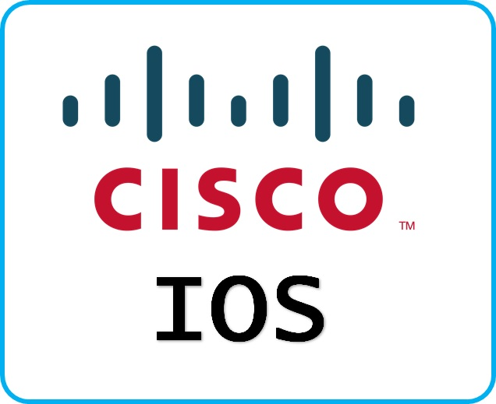
IP Addressing
Cisco technology is built around the Cisco Internetwork Operating System (IOS), which is the software that controls the routing and switching functions of internetworking devices.
A solid understanding of the IOS is essential for a network administrator.

Slide 3
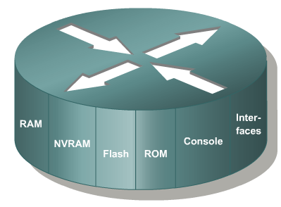
Router Memory Component
ROM
FLASH Memory
RAM
NVRAM
-

Slide 4
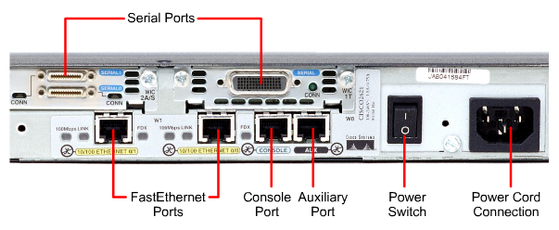
External Components of a 2600 Router

Slide 5
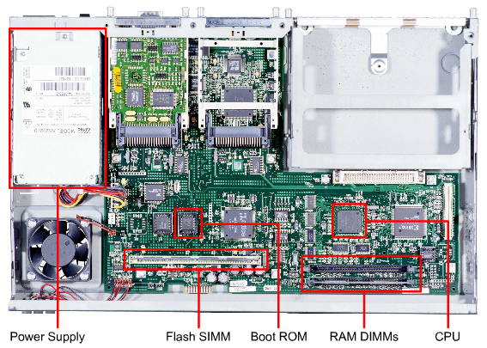
Internal Components of a 2600 Router

Slide 6
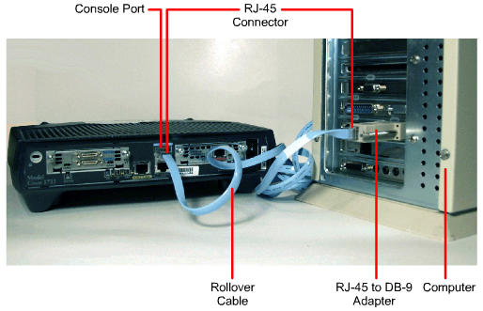
Computer/Terminal Console Connection

Slide 7
Thank You ALL

